Slide 1
Fast Fourier Transform
cs208
by wwy
*https://www.youtube.com/watch?v=h7apO7q16V0&feature=emb_logo

Slide 2





Polynomial Multiplication
$$A(x)=x^{2}+3x+2$$
How to storage
$$B(x)=2x^{2}+1$$
$$C(x)=A(x)∙B(x)$$
$$C(x)=(x^{2}+3x+2)∙(2x^{2}+1)$$
$$C(x)=x^{2}(2x^{2}+1)+3x(2x^{2}+1)+2(2x^{2}+1)$$
$$C(x)=2x^{4}+x^{2}+6x^{3}+3x+4x^{2}+2$$
$$C(x)=2x^{4}+6x^{3}+5x^{2}+3x+2$$

Slide 3



Polynomial Multiplication
$$A(x)=x^{2}+3x+2$$
$$A=[1,3,2]$$
$$B(x)=2x^{2}+1$$
$$B=[1,0,2]$$
$$C(x)=A(x)∙B(x)$$
$$C(x)=(x^{2}+3x+2)∙(2x^{2}+1)$$
$$C(x)=x^{2}(2x^{2}+1)+3x(2x^{2}+1)+2(2x^{2}+1)$$
$$C(x)=2x^{4}+x^{2}+6x^{3}+3x+4x^{2}+2$$
$$C(x)=2x^{4}+6x^{3}+5x^{2}+3x+2$$
$$C=[2,3,5,6,2]$$
Coefficient Representation

Slide 4
Polynomial Multiplication
$$A(x)=a_{0}+a_{1}x+a_{2}x^{2}+⋯+a_{d}x^{d}$$
$$B(x)=b_{0}+b_{1}x+b_{2}x^{2}+⋯+b_{d}x^{d}$$
$$C(x)=c_{0}+c_{1}x+c_{2}x^{2}+⋯+c_{2d}x^{2d}$$
O(d^2)

Slide 5
Polynomial Multiplication
(d+1) points uniquely define a degree d ploynomial
$$P(x)=p_{0}+p_{1}x+p_{2}x^{2}+...+p_{n}x^{d}$$
Value Representation
$$\{(x_{0},P(x_{0})),(x_{1},P(x_{1})),...,(x_{d},P(x_{d}))\}$$

Slide 6


Polynomial Multiplication
d=4
$$A(x)=x^{2}+3x+2$$
$$B(x)=2x^{2}+1$$
$$C(x)=A(x)∙B(x)$$
$$C(x)=2x^{4}+6x^{3}+5x^{2}+3x+2$$
$$\{(−2,0),(−1,0),(0,2),(1,6),(2,12)\}$$
5 points
$$\{(−2,9),(−1,3),(0,1),(1,3),(2,9)\}$$
$$\{(−2,0),(−1,0),(0,2),(1,18),(2,108)\}$$
O(d)

Slide 7
Polynomial Multiplication
$$A(x)=a_{0}+a_{1}x+a_{2}x^{2}+⋯+a_{d}x^{d}$$
$$C(x)=c_{0}+c_{1}x+c_{2}x^{2}+⋯+c_{2d}x^{2d}$$
$$B(x)=b_{0}+b_{1}x+b_{2}x^{2}+⋯+b_{d}x^{d}$$
Coef=>Value
Value=>Coef
FFT
Multiply

Slide 8
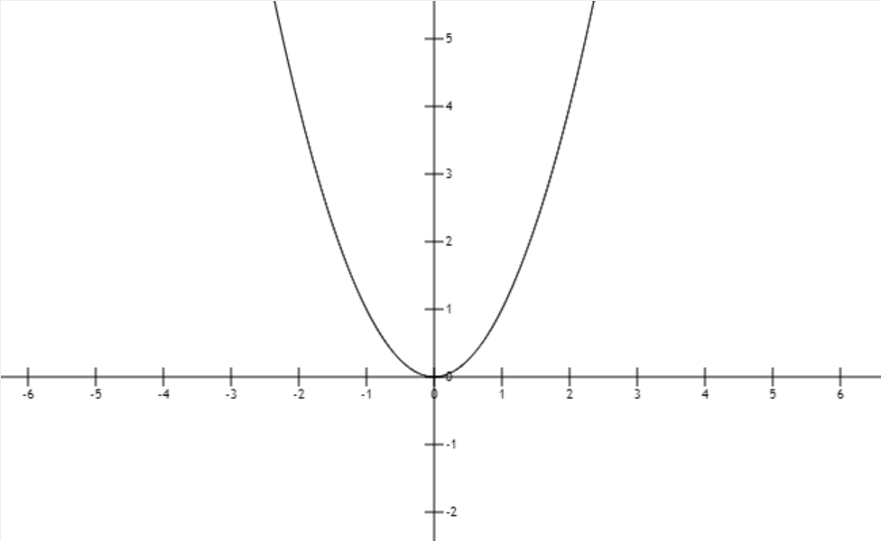
Polynomial Multiplication
$$A(x)=a_{0}+a_{1}x+a_{2}x^{2}+⋯+a_{d}x^{d}$$
$$B(x)=b_{0}+b_{1}x+b_{2}x^{2}+⋯+b_{d}x^{d}$$

Slide 9
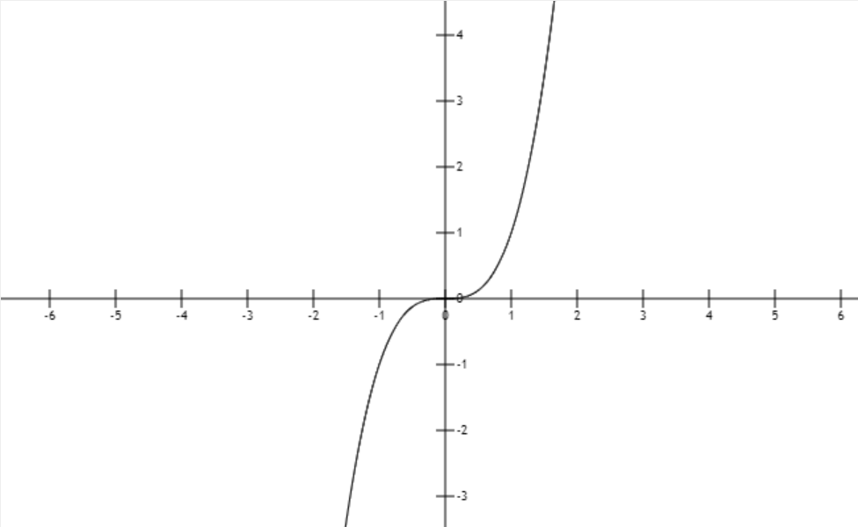
Polynomial Multiplication
$$A(x)=a_{0}+a_{1}x+a_{2}x^{2}+⋯+a_{d}x^{d}$$
$$B(x)=b_{0}+b_{1}x+b_{2}x^{2}+⋯+b_{d}x^{d}$$
even
odd

Slide 10







Polynomial Multiplication
$$A(x)=a_{0}+a_{1}x+a_{2}x^{2}+⋯+a_{d}x^{d}$$
$$B(x)=b_{0}+b_{1}x+b_{2}x^{2}+⋯+b_{d}x^{d}$$
eg
O(nlogn)
$$A(x)=3x^{5}+2x^{4}+x^{3}+7x^{2}+5x+1$$
$$A(x)=(2x^{4}+7x^{2}+1)+x(3x^{4}+x^{2}+5)$$
$${A_{e}(x^{2})=A}_{e}(y)=2y^{2}+7y+1$$
$$A_{e}(x^{2})$$
$$A_{o}(x^{2})$$
$${A_{o}(x^{2})=A}_{o}(y)=3y^{2}+y+5$$
$$A(x)=A_{e}(x^{2})+xA_{o}(x^{2})$$
4th power->square
$$A(x_{i})=A_{e}(x_{i}^{2})+x_{i}A_{o}(x_{i}^{2})$$
$$A({−x}_{i})=A_{e}(x_{i}^{2})−x_{i}A_{o}(x_{i}^{2})$$
Recursion?Merge conquer？

Slide 11
Polynomial Multiplication
$$A(x)=a_{0}+a_{1}x+a_{2}x^{2}+⋯+a_{d}x^{d}$$
$$B(x)=b_{0}+b_{1}x+b_{2}x^{2}+⋯+b_{d}x^{d}$$
eg
$$A(x)=3x^{5}+2x^{4}+x^{3}+7x^{2}+5x+1$$
$$A(x)=(2x^{4}+7x^{2}+1)+x(3x^{4}+x^{2}+5)$$
$${A_{e}(x^{2})=A}_{e}(y)=2y^{2}+7y+1$$
$$A_{e}(x^{2})$$
$$A_{o}(x^{2})$$
$${A_{o}(x^{2})=A}_{o}(y)=3y^{2}+y+5$$
$$A(x)=A_{e}(x^{2})+xA_{o}(x^{2})$$
$$A(x_{i})=A_{e}(x_{i}^{2})+x_{i}A_{o}(x_{i}^{2})$$
$$A({−x}_{i})=A_{e}(x_{i}^{2})−x_{i}A_{o}(x_{i}^{2})$$
Recursion?Merge conquer？

Slide 12
Polynomial Multiplication
$$A(x)=a_{0}+a_{1}x+a_{2}x^{2}+⋯+a_{d}x^{d}$$
$$B(x)=b_{0}+b_{1}x+b_{2}x^{2}+⋯+b_{d}x^{d}$$
eg
$$A(x)=3x^{5}+2x^{4}+x^{3}+7x^{2}+5x+1$$
$$A(x)=(2x^{4}+7x^{2}+1)+x(3x^{4}+x^{2}+5)$$
$${A_{e}(x^{2})=A}_{e}(y)=2y^{2}+7y+1$$
$$A_{e}(x^{2})$$
$$A_{o}(x^{2})$$
$${A_{o}(x^{2})=A}_{o}(y)=3y^{2}+y+5$$
$$A(x)=A_{e}(x^{2})+xA_{o}(x^{2})$$
Recursion，Merge conquer
$$A(x_{i})=A_{e}(x_{i}^{2})+x_{i}A_{o}(x_{i}^{2})$$
$$A({−x}_{i})=A_{e}(x_{i}^{2})−x_{i}A_{o}(x_{i}^{2})$$
real number->complex num

Slide 13

Polynomial Multiplication
$$A(x)=a_{0}+a_{1}x+a_{2}x^{2}+⋯+a_{d}x^{d}$$
Recursion，Merge conquer
eg
real number->complex num
$$A(x)=x^{3}+x^{2}−x−1$$
x₁
-x₁
x₂
-x₂
x₁
-x₁
x₂
-x₂
x₁²
-x₁²
x₁²
x₂²
x₁²
?

Slide 14
Polynomial Multiplication
$$A(x)=a_{0}+a_{1}x+a_{2}x^{2}+⋯+a_{d}x^{d}$$
eg
$$A(x)=x^{3}+x^{2}−x−1$$
1
-1
i
-i
1
-1
1

Slide 15
Polynomial Multiplication
6 points->8 pts(2³)
$$A(x)=a_{0}+a_{1}x+a_{2}x^{2}+⋯+a_{d}x^{d}$$
$$A(x)=3x^{5}+2x^{4}+x^{3}+7x^{2}+5x+1$$
eg
eg
x1
-x1
x2
-x2
x3
-x3
x4
-x4
$$A(x)=x^{3}+x^{2}−x−1$$
1
-1
i
-i
1
-1
i
-i
1
-1
1
-1
1
1

Slide 16
Polynomial Multiplication
6 points->8 pts(2³)
$$A(x)=a_{0}+a_{1}x+a_{2}x^{2}+⋯+a_{d}x^{d}$$
$$A(x)=3x^{5}+2x^{4}+x^{3}+7x^{2}+5x+1$$
eg
eg
x1
-x1
x2
-x2
x3
-x3
x4
-x4
$$A(x)=x^{3}+x^{2}−x−1$$
1
-1
i
-i
1
-1
i
-i
1
-1
1
-1
1
Nth root of unity?
1

Slide 17
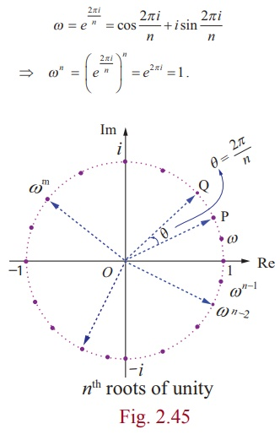


Polynomial Multiplication
Nth root of unity
$$e^{iθ}=cos(θ)+isin(θ)$$
$$ω^{j+n/2}=−ω^{j}$$
we wanna know A(x) at 1,w, w²,...,w^{n-1} (n=2^{k})
so you can do the Recursion!
*https://www.brainkart.com/article/The-nth--roots-of-unity_39108/

Slide 18


















FFT
$$P(x):[p_{0},p_{1},...,p_{n−1}]$$
$$ω=e^{\frac{2πi}{n}}:[ω^{0},ω^{1},...,ω^{n−1}]$$
$$when n=1,P(1): n=2^{k}$$
$$P_{e}(x^{2}):[p_{0},p_{2},...,p_{n−2}]$$
$$[ω^{0},ω^{2},...,ω^{n−2}]$$
$$P_{o}(x):[p_{1},p_{3},...,p_{n−1}]$$
$$[ω^{0},ω^{2},...,ω^{n−2}]$$
$$y_{e}=[P_{e}(ω^{0}),P_{e}(ω^{2}),...,P_{e}(ω^{n−2})]$$
$$y_{o}=[P_{o}(ω^{0}),P_{o}(ω^{2}),...,P_{o}(ω^{n−2})]$$
$$P(x_{j})=P_{e}(x_{j}^{2})+x_{j}P_{o}(x_{j}^{2})$$
$$P(ω^{j})=P_{e}(ω^{2j})+ω^{j}P_{o}(ω^{2j})$$
$$P(ω^{j})=P_{e}(ω^{2j})+ω^{j}P_{o}(ω^{2j})$$
$$x_{j}=ω^{j}$$
$$P(−x_{j})=P_{e}(x_{j}^{2})−x_{j}P_{o}(x_{j}^{2})$$
$$P(−ω^{j})=P_{e}(ω^{2j})−ω^{j}P_{o}(ω^{2j})$$
$$P(ω^{j+n/2})=P_{e}(ω^{2j})−ω^{j}P_{o}(ω^{2j})$$
$$−ω^{j}=ω^{j+n/2}$$
$$j∈\{0,1,...,(\frac{n}{2}−1)\}$$
$$j∈\{0,1,...,(\frac{n}{2}−1)\}$$
$$j∈\{0,1,...,(\frac{n}{2}−1)\}$$
$$P(ω^{j})=y_{e}[j]+ω^{j}y_{o}[j]$$
$$y_{e}[j]=P_{e}(ω^{2j})$$
$$P(ω^{j+n/2})=y_{e}[j]−ω^{j}y_{o}[j]$$
$$y_{o}[j]=P_{o}(ω^{2j})$$
$$j∈\{0,1,...,(\frac{n}{2}−1)\}$$

Slide 19
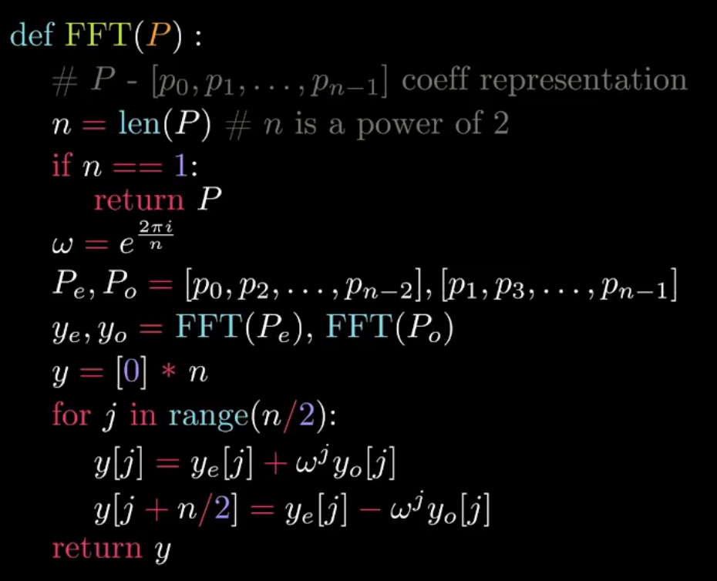





FFT
$$P(x):[p_{0},p_{1},...,p_{n−1}]$$
$$ω=e^{\frac{2πi}{n}}:[ω^{0},ω^{1},...,ω^{n−1}]$$
$$when n=1,P(1): n=2^{k}$$
$$P_{e}(x^{2}):[p_{0},p_{2},...,p_{n−2}]$$
$$[ω^{0},ω^{2},...,ω^{n−2}]$$
$$y_{e}=[P_{e}(ω^{0}),P_{e}(ω^{2}),...,P_{e}(ω^{n−2})]$$
$$P_{o}(x):[p_{1},p_{3},...,p_{n−1}]$$
$$[ω^{0},ω^{2},...,ω^{n−2}]$$
$$y_{o}=[P_{o}(ω^{0}),P_{o}(ω^{2}),...,P_{o}(ω^{n−2})]$$
$$P(ω^{j})=y_{e}[j]+ω^{j}y_{o}[j]$$
$$P(ω^{j+n/2})=y_{e}[j]−ω^{j}y_{o}[j]$$
$$j∈\{0,1,...,(\frac{n}{2}−1)\}$$
$$y=[P(ω^{0}),P(ω^{1}),...,P(ω^{n−1})]$$

Slide 20
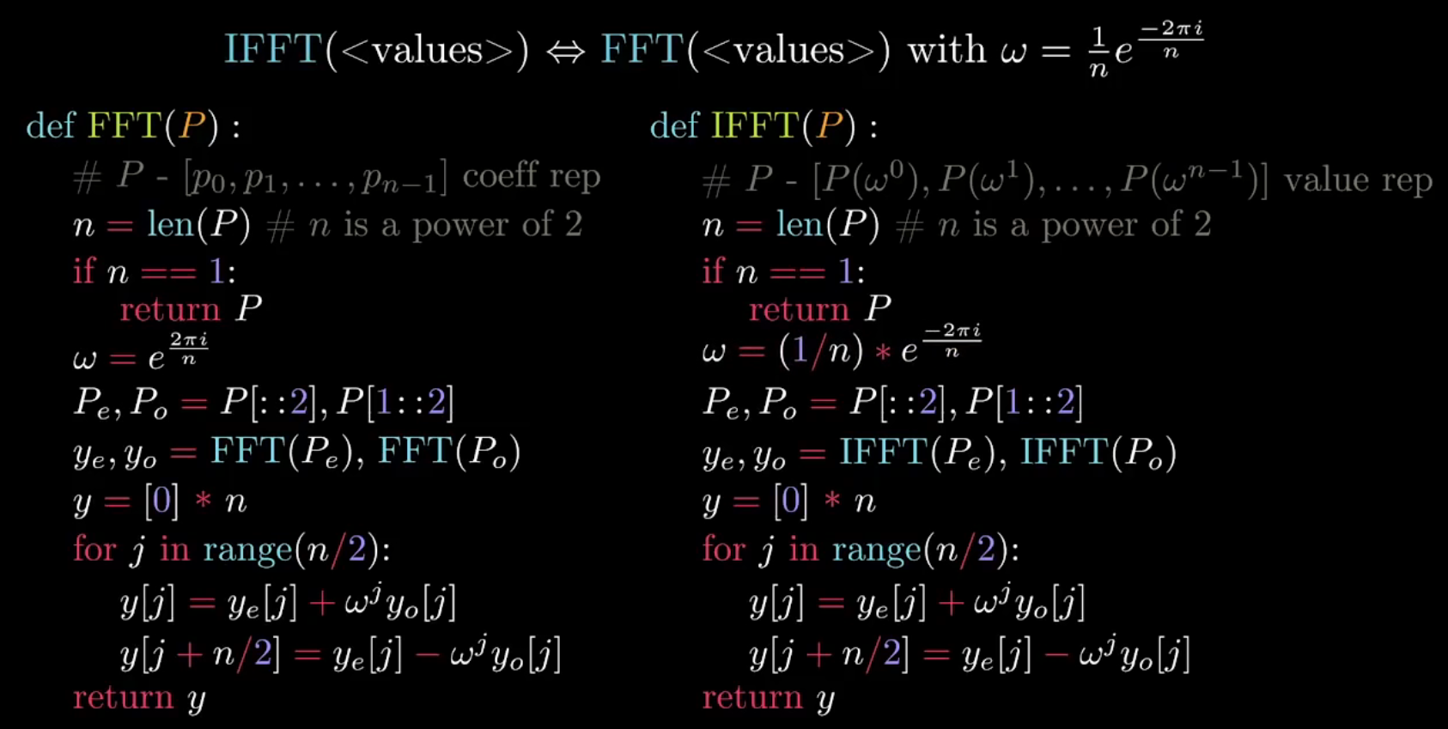
FFT vs IFFT

Slide 21
THX :-)

